Slide 1

Catalysts for change: Unveiling Effective Community-based Interventions with the power of PowerApps
National Center for Immunization & Respiratory Diseases
Kimberly Y Jones, MPH, CSM
Public Health Informatics Fellowship Program
Global Influenza Branch
Influenza Division
National Center for Immunization & Respiratory Diseases
PHIFP Info-Aid Showcase 2024
March 8, 2024
Notes:
Hello my name is Kimberly Jones
Title of my presentation is: (Read above)

Slide 2
Disclaimer
The findings and conclusions in this presentation are those of the author and do not necessarily represent the views of the Centers for Disease Control and Prevention.
1
Notes:
The thoughts and findings of this presentation is that of the presenter and not that of CDC

Slide 3
Outline
Background/Public Health Context​
Informatics Problem​
Solution Approach​
Project Outcomes​
Recommendations​
Lessons Learned/Next steps​
Acknowledgements
2
Notes:
I will be addressing the following topics in the outline

Slide 4

CDC Community Guide Program
Supports Community Preventative Services Task Force (CPSTF)
Review findings from systematic reviews
Improving health outcomes
3
Notes:
CDC Community Guide program supports the Community Preventative Services Task Force, who serves as a panel of public health experts tasked with evaluating the effectiveness and economic impact of community-based evidence interventions.
In addressing public health challenges, the CPSTF plays a pivotal role in providing evidence-based recommendations to guide policy making and resource allocations.
The CPSTF’s systematic reviews highlight the multifaceted nature of community-based preventive services, emphasizing both their effectiveness in improving health outcomes and their potential economic impact

Slide 5
Develop a robust data system tailored to the needs of the Community Guide Program
Interactive documentation tool
Data storage
Integration for data visualization
Training
4
Notes:
Problems that needed to be solved was divided into 2 categories
Technology and Technical Expansion (Myself)
Interactive Reports and Dashboards (Stephen Swanik)
My primary focus was to understand where and how much data was being collected, evaluate who had access to the data and provide a low/no code solution for the Community Guide Program
Interactive tool for documentation
Central data hub (storage)
Integration of data for data visualization
Trainings to enhance users’ experience

Slide 6
User Centric Approach
Research
Personas
Prototype
Iterative Designs
User Testing
Accessibility
Feedback Integration
Journey Mapping
User Interface Design
Continuous Learning
1
2
3
4
5
6
7
8
9
10
5
Notes:
The user centric approach places the needs and experiences of the user at the forefront of the design and development process.
This methodology focuses on 10 steps making sure that the user needs are met by offering them the ability to be part of the design phase, making real time changes as requested and cultivating an atmosphere for teaching as we go.

Slide 7
Factors that influence the User Experience (UX)
Valuable
Useful
Desirable
Accessible
Usable
Credible
Findable
6
Notes:
As stated previously the CDC Community Group needed a tool that would offer accessibility to the community in which they serve.
The tool needed to be findable (internal), usable, and to showcase the systematic review metrics for valuable and creditable reporting.

Slide 8
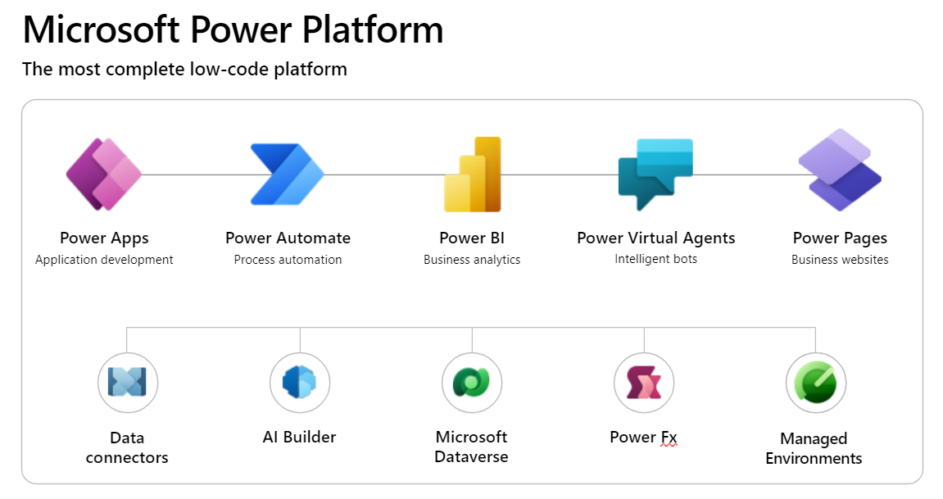
Enterprise Solution
7
Notes:
Keeping in alignment with CDC Enterprise solutions I thought it would be best to incorporate Microsoft low code platform.
It was expressed early on that the solution needed to have minimal coding, easy staff training and limited funding resources.
Power Apps will be used to collect data in real time
Data will be managed in site specific default environment
With the help of MS data connectors, the key metrics will display by utilizing Power BI

Slide 9





DATA MODEL
Web metric data from WCMS stored
Connectors used to connect data from SharePoint into Power BI
SharePoint
Power App
Users
SharePoint
Power BI
Azure SQL
Data was rewritten back from Power App into SharePoint and looped back into Power BI
8
This Photo by Unknown Author is licensed under CC BY
This Photo by Unknown Author is licensed under CC BY
Notes:
The data model now encompasses a more streamline workflow of data collection, data storing, accessibility and timely reporting.
Data was created using MS List that was later converted into a Power App.
Power App Canvas allows for interactive data entry. Once users submit their form the data is stored back into the SharePoint data repository.
Data from SharePoint would then be pulled into Power BI for data visualizations using a connector.
I was able to connect near real time web metric data by connecting to MS Azure Datalake into the Power BI.

Slide 10
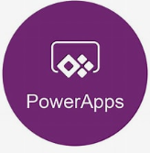
Robust Data Entry Tool
Notes:
On to the App

Slide 11
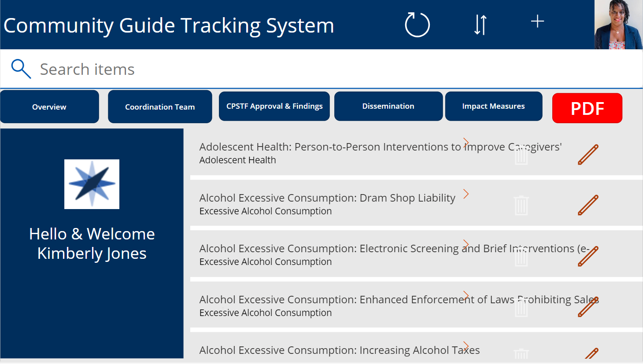
10
Notes:
Community Guide users are met with their agency branding
A nice hello welcoming with name and photo (coded with O365 account log ins)
User will begin documentation with selecting the plus sign near photo

Slide 12
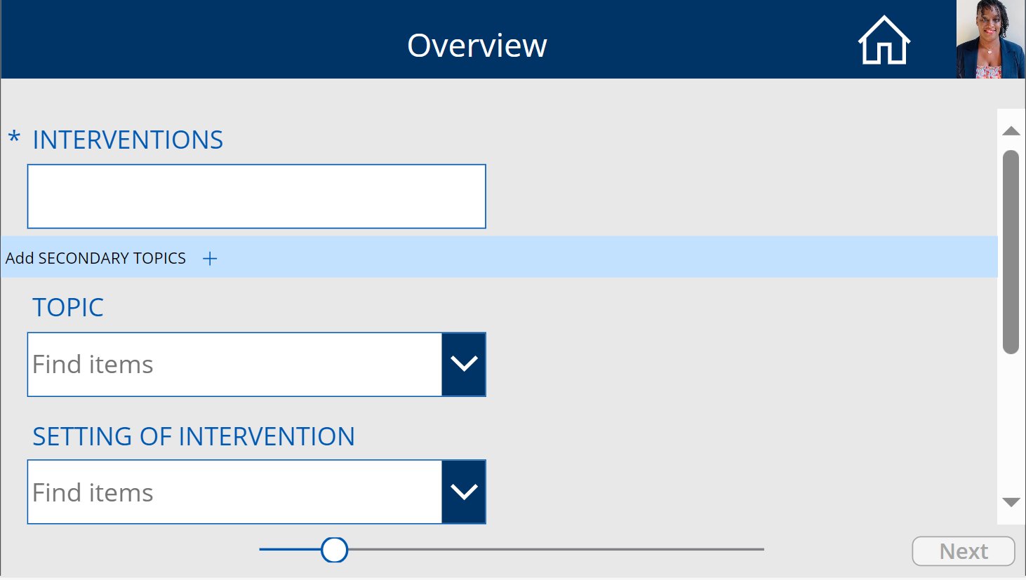
Notes:
Power Apps is an interactive documentation tool for real time data entry
Starting on the overview screen, users begin documenting data navigating through the form.
There was some customized columns that displays the * asterisk symbol , “required” fields.
Form will not forward until all required fields are entered and shown by “grey out” next icon
I was able to code cascading rows that as users select the plus sign additional rows will be added to form

Slide 13
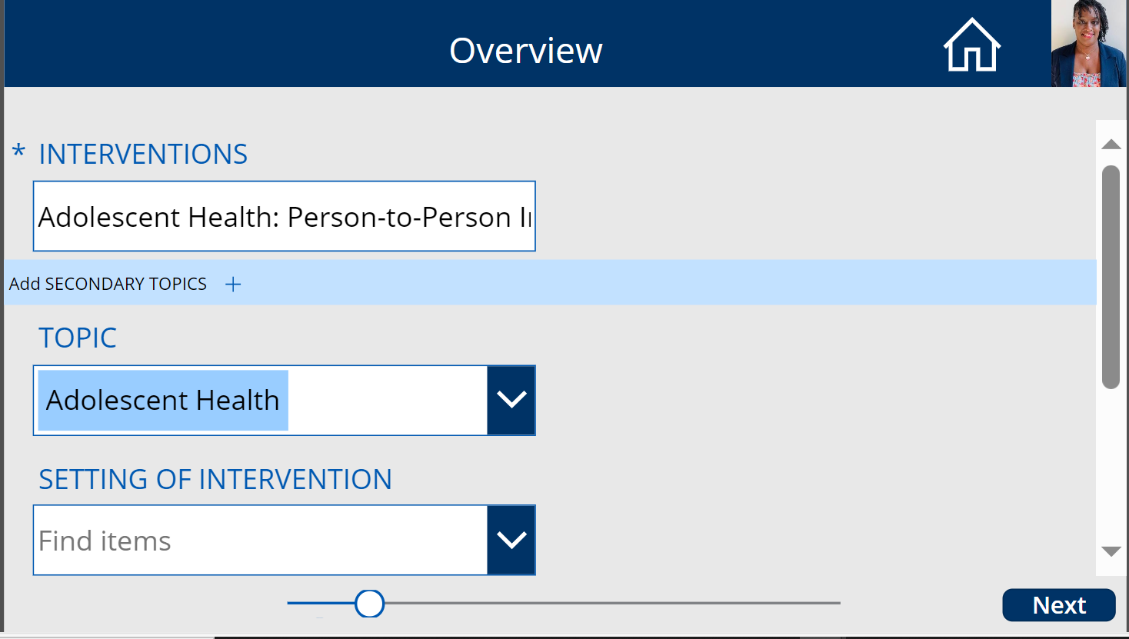
Notes:
Once they are filled in with information, the next button will go from grey to blue.

Slide 14
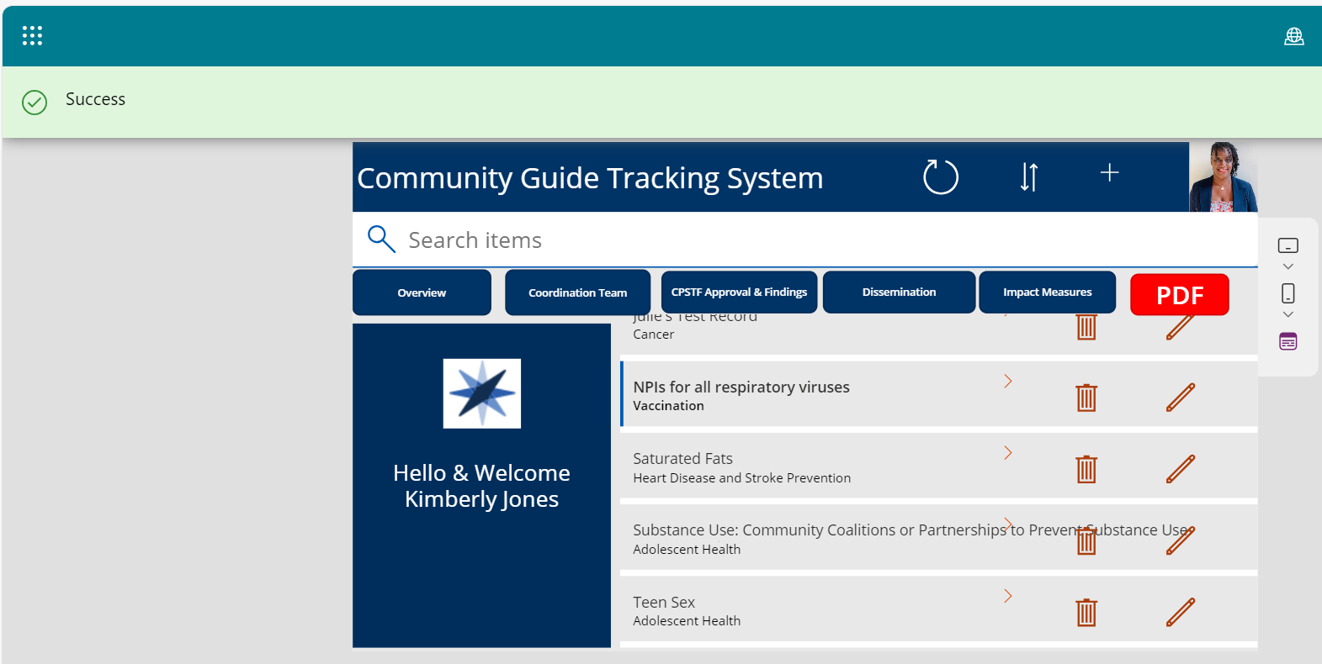

13
Notes:
Once all data is collected and submitted, users will be presented with a green ”success” banner and brough back to home screen..

Slide 15
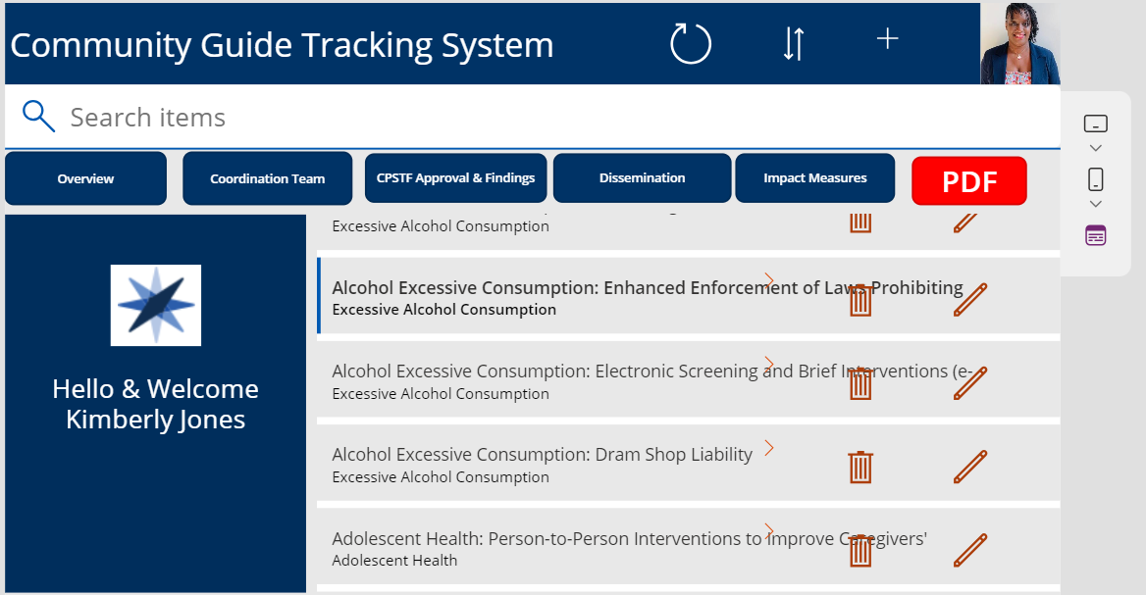
14
Notes:
Once all data is collected the end users have a gallery view of documented work.

Slide 16
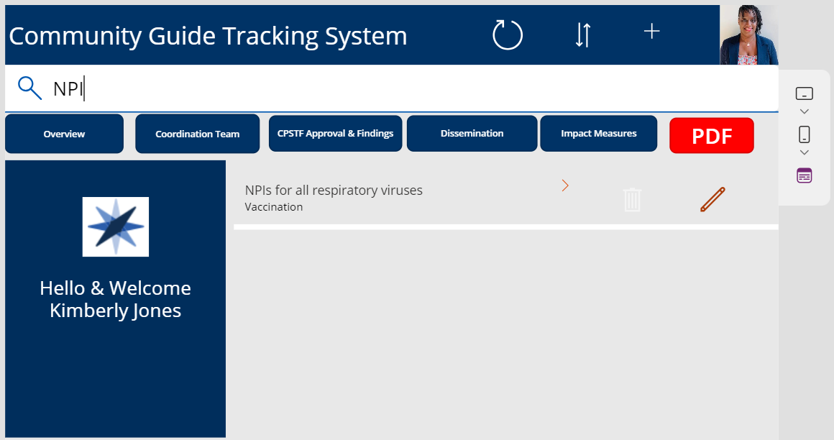
15
Notes:
Users can search a topic based on the title description by keying in a few letters.
Users can simply click on the arrow to open and read content.
For data security the delete function represented by the trash can is fade out in white so users don’t mistakenly delete content

Slide 17
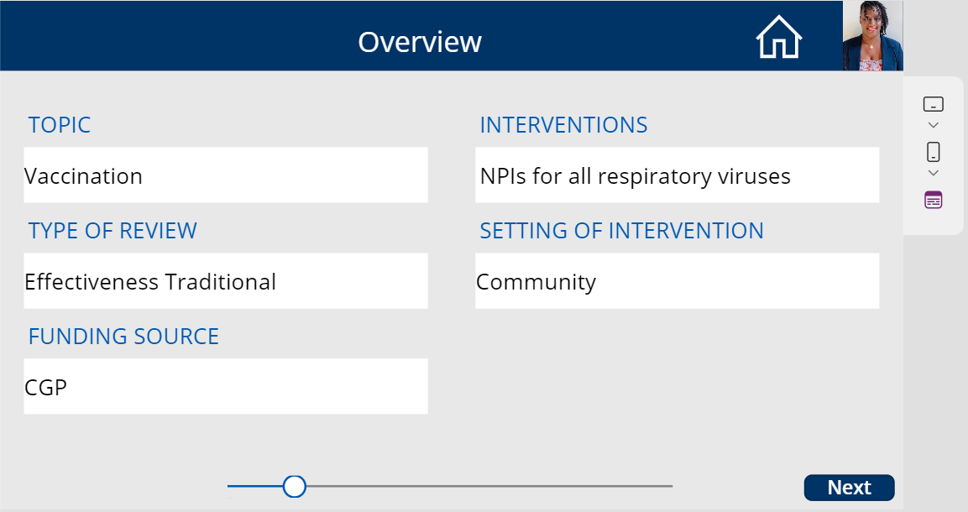
16
Notes:
We are now in the “view only” mode [background is grey] where users can read content.
If all is complete the staff can click on home tab to go back to homescreen.

Slide 18
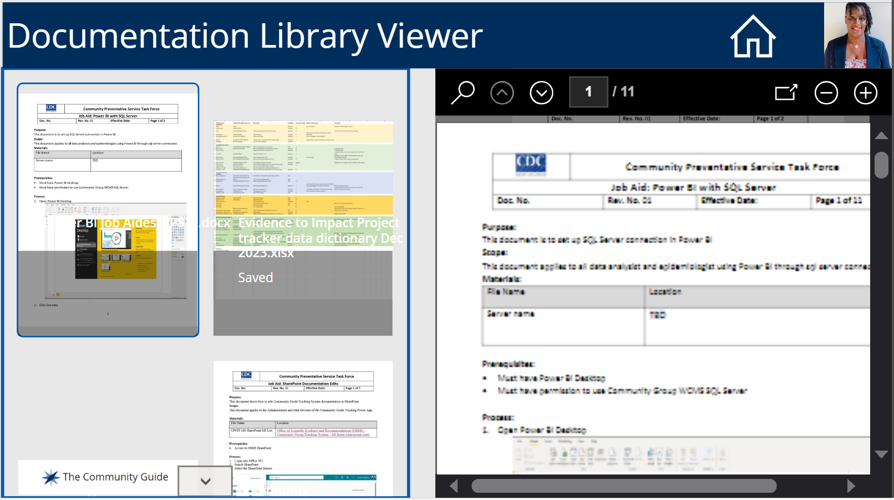
Notes:
I was also able to create a workflow to view various types of documents into the PDF view that would later be stored into a designated folder on the SharePoint site.

Slide 19
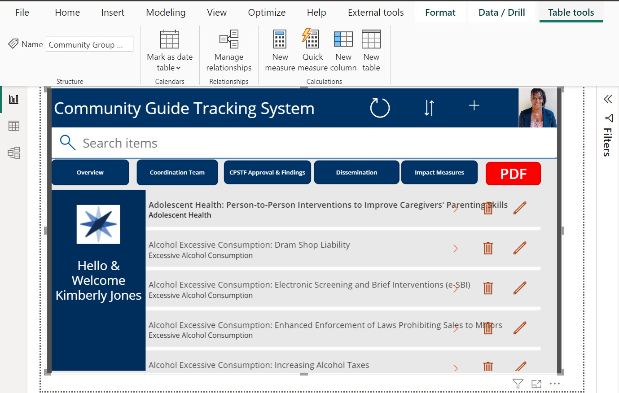
Embedded Power App into Power BI
Notes:
The beauty of using the Microsoft platform is the interconnection of the product. As you can see from this slide I was able to embed the Power App into the Power BI dashboard for easy accessibility

Slide 20
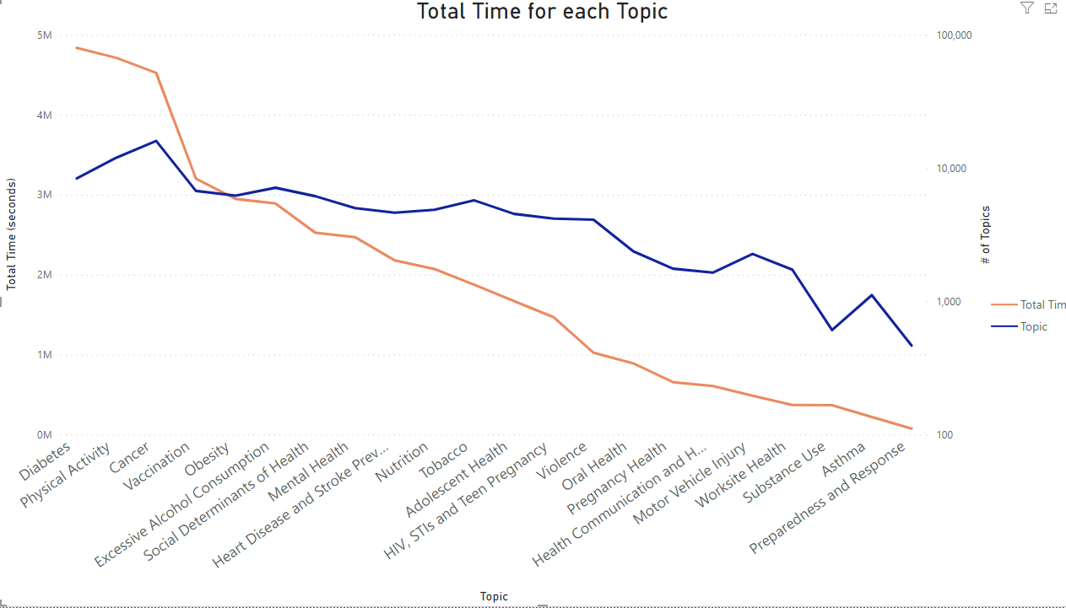
Data Visuals
18
Notes:
This transparent depiction of web analytics underscores the platform’s efficacy in providing actionable insights and informing strategic decision making within CGP. In 2023, the public searches were highest between Diabetes, Physical Activity and Cancer out of 21 topics at a rate of 5 million seconds per hit in a day (3 days behind)

Slide 21
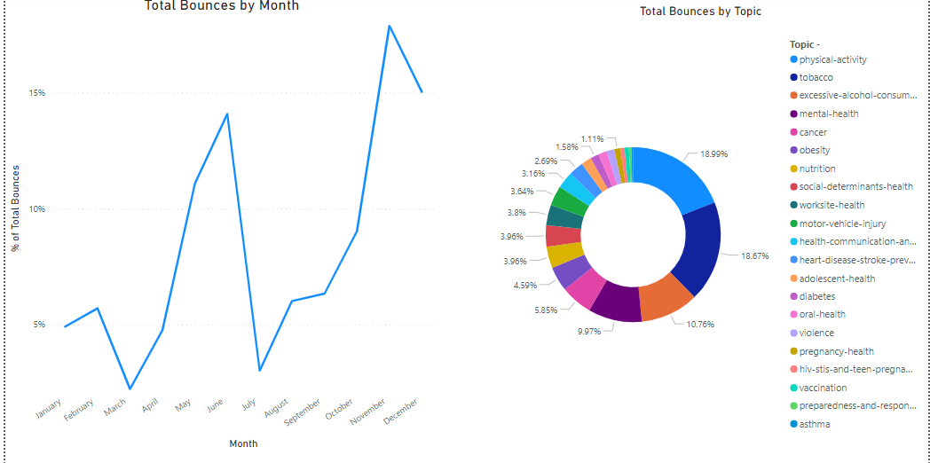
Data Visuals
19
Notes:
In 2023, we can also see the percentage of people that landed on the Community Guide Program web page (bounce totals)
Again, physical activity with the highest percentage in the summer months and again in the fall (back to school and holiday time)

Slide 22
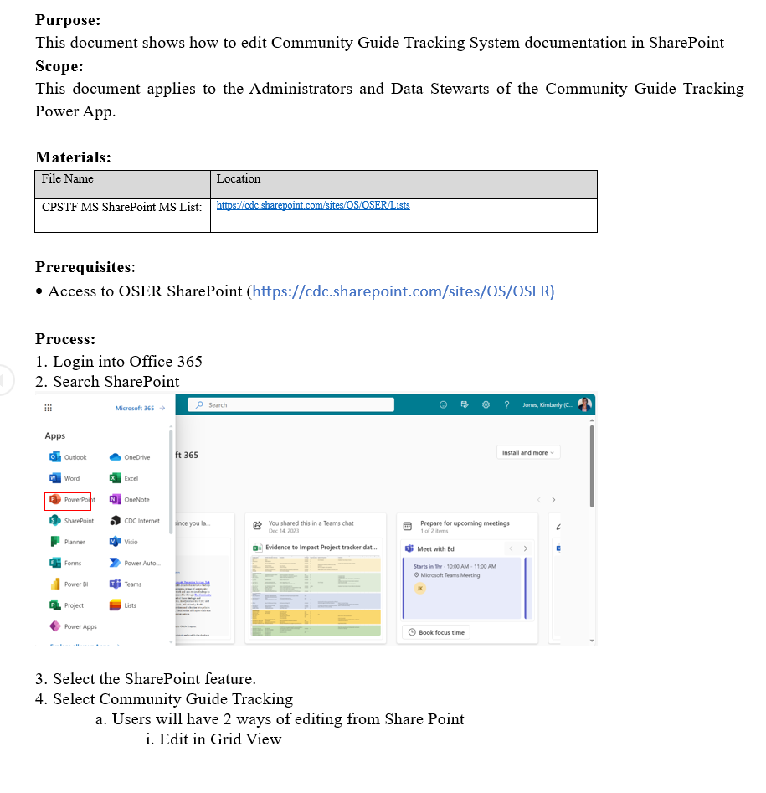
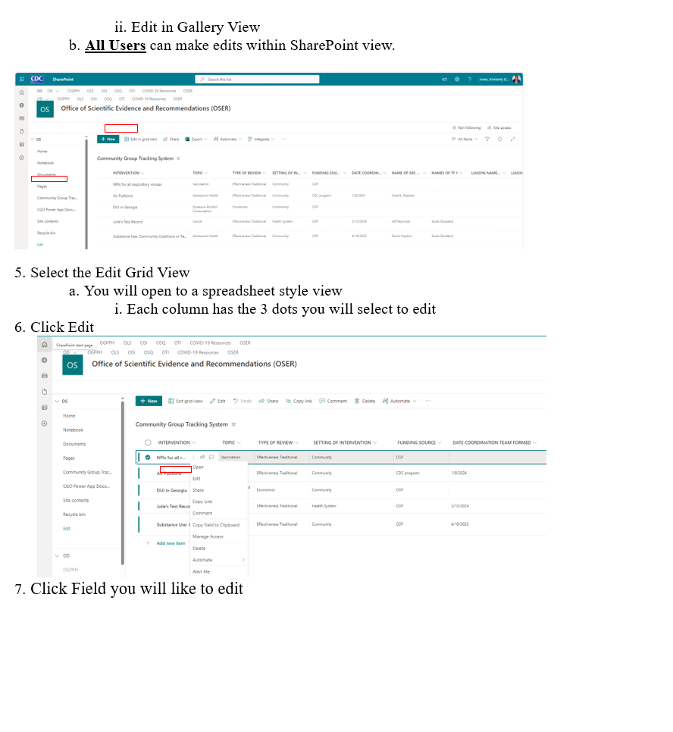
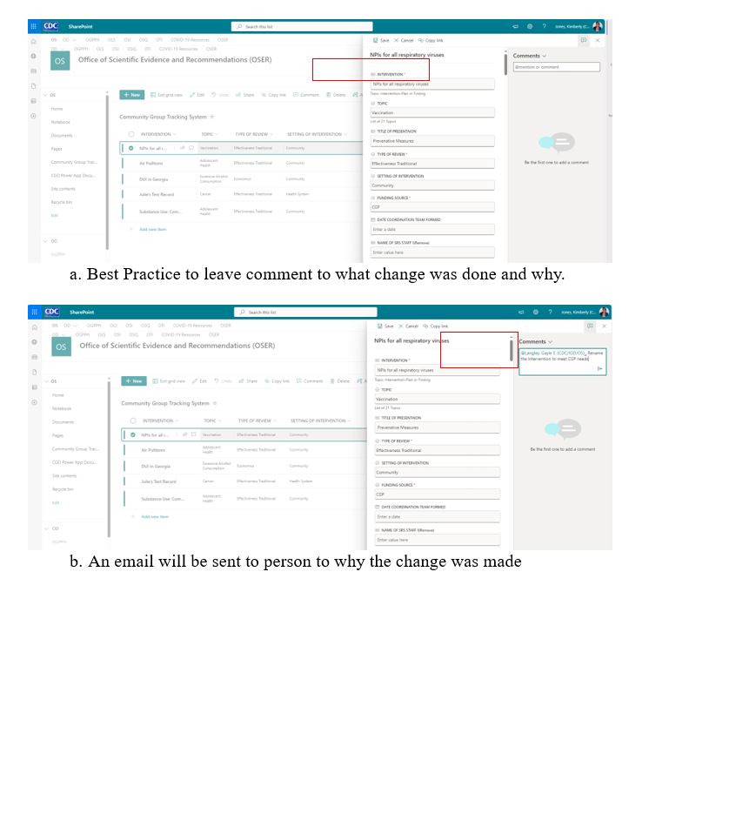
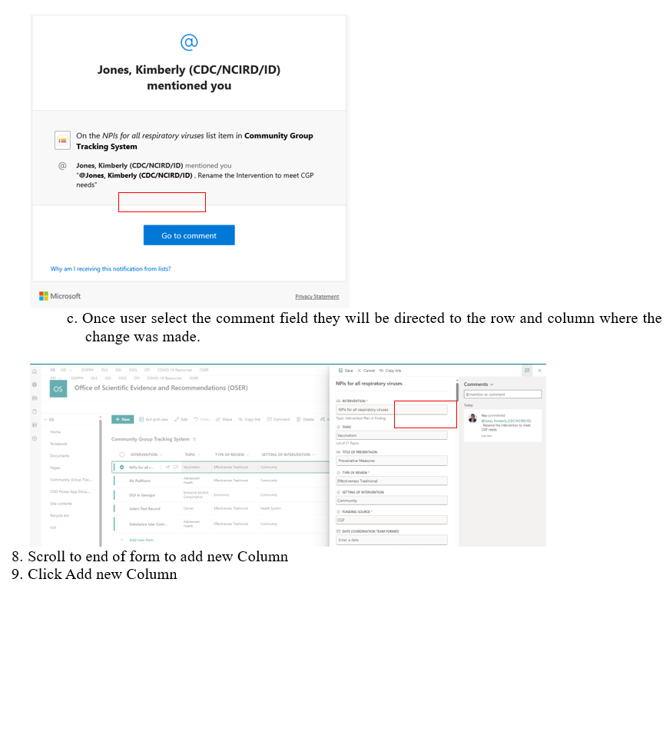

Knowledge Builder
Notes:
Training was fundamental for the success of the implementation of the project, I was able to create various tip sheets for the developers, data stewards, and the end users that will be using the Power App application.

Slide 23
Best Practice of Power Apps
Microsoft List
Power App
Environments
21
Notes:
Best Practices were evaluated early in the project since there was a prototype that was offered as an example.
Team learned:
- Personal MS lists should be exported into Excel/CSV and uploaded to a collaborative SharePoint site or the ability to edit will be impossible.
- You can create Power App from a list but later down the line the ability to share or edit, there will be some issues with migration of the data.
Publishing environments matter!!
Default = End users will see changes
SharePoint Permissions for designing, managing or edits rights.
DEV/PRD = Only the developers will see changes and controls what will be uploaded into the cloud. ***Do Not select Publish*** if you don’t want end users to view
Version Control
Users have 6 months to reactivate a deleted item. It is recommended to store data in cloud

Slide 24
Recommendations
SharePoint Support
Power Automate
Chatbot
DataVerse
22
Notes:
1. SharePoint support to assist with any complex coding needs
2. Microsoft suite has Power Automate that can be incorporated into Power App for automation of various workflows
2. Chatbot feature is coming and will be a great access to help communities to use AI to locate information within Power App
3. Scaling up to dataverse in the future to allow for more data storage and increased data security

Slide 25
Next Steps
Iterative Design
Bibliometrics
23
Notes:
Power App is fun tool that can offer versatility. As CGP staff uses the tool, they will want more iterative designs
Bibliometrics incorporated into the data analytics for publications surrounding the publication work.

Slide 26
Lessons Learned
Scoping of Project Resources
Accessibility to certain tools
Time Allotment
24
Notes:
Even though the staff of NCIRD and Center for Global health was accommodating, I could have done a better job of identifying those users within Community Guide Program, to assist earlier in the process
As a skilled informatician, working as a fellow limits the accessibilities of tools such as ShareGate to transport the work from one branch to another.
Time was a huge factor as my work was contingent on various coding styles (Declarative programming, Data Analysis Expressions & Structural query languages) and I had to rebuild the Power App over due to the inability to migrate causing for multiple errors in the programming

Slide 27
References:
Creating a User-Centered Approach in Government | Usability.gov
PowerApps Canvas App Coding Standards and Guidelines | Microsoft Power Apps
De Vito Dabbs A, Myers BA, Mc Curry KR, Dunbar-Jacob J, Hawkins RP, Begey A, Dew MA. User-centered design and interactive health technologies for patients. Comput Inform Nurs. 2009 May-Jun;27(3):175-83. doi: 10.1097/NCN.0b013e31819f7c7c. PMID: 19411947; PMCID: PMC2818536.
25

Slide 28
Acknowledgments
Community Guide Program Staff & Partners
Gayle Langley, MD, MPH
Julie Racine-Parshall, BS
Arielle Arnold, MS
Steve Gu, SharePoint Developer
Ismail Abdul, Database Administrator
NCIRD STAFF
Lindsey Duca, PhD, - Team Lead
Robin Spratling, MPH – Health Communication Specialist
Tariq Galloway, SharePoint Developer
GHC Staff
Alexander Sanders, Computer Programmer
PHIF Colleagues
Megha Ganewatta, MPH
Sonya Zhan, PharmD, MSHI
PHIF Program Staff
Jeffery Gordon, PhD – Info-Aid Advisor
Brianne Yassine, PhD, MPH – Health Education Specialist
Wilfred Bonney, Ph.D – Capstone Advisor
26

Slide 29

For more information contact:
Kimberly Jones, MPH
Email: qos2@cdc.gov
Notes:
Thank you! Any questions?

